Slide 1
Session 11
Queue, Deque, and Stack
Math class

Slide 2
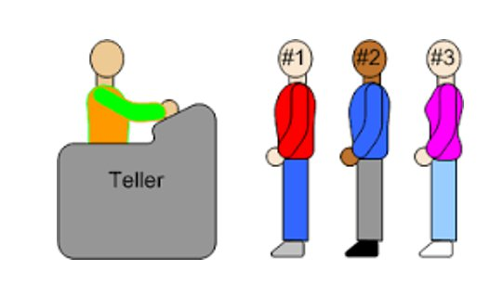
Queue:
A Queue is a data structure that follows the FIFO (First-In-First-Out) principle.
Elements are inserted at the rear (end) and removed from the front (beginning).
Java provides the Queue interface in the java.util package.
Common Queue Implementations: 1. LinkedList: Can be used as a basic queue implementation. 2. ArrayDeque: A more efficient and resizable implementation.
Basic Operations: add(element): Adds an element to the rear of the queue. remove(): Removes and returns the element from the front of the queue. peek(): Returns the element at the front of the queue without removing it. isEmpty(): Checks if the queue is empty. size(): Returns the number of elements in the queue.

Slide 3
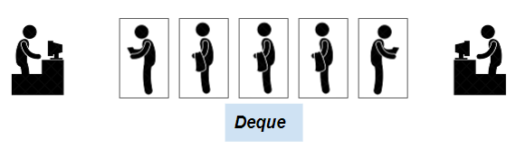
Deque (Double Ended Queue):
A Deque is a data structure that supports insertion and removal at both ends.
It can be used as a queue or a stack depending on the requirement.
Java provides the Deque interface in the java.util package.
Common Deque Implementations: 1. LinkedList: Can be used as a basic deque implementation. 2. ArrayDeque: A more efficient and resizable implementation.
Basic Operations:
addFirst(element): Adds an element to the front of the deque. addLast(element): Adds an element to the rear of the deque. removeFirst(): Removes and returns the element from the front of the deque. removeLast(): Removes and returns the element from the rear of the deque. peekFirst(): Returns the element at the front of the deque without removing it. peekLast(): Returns the element at the rear of the deque without removing it. isEmpty(): Checks if the deque is empty. size(): Returns the number of elements in the deque.

Slide 4
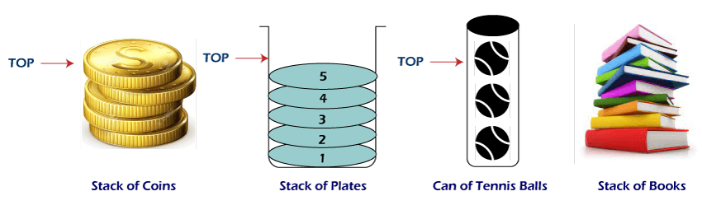
Stack:
A Stack is a data structure that follows the LIFO (Last-In-First-Out) principle. Elements are pushed onto the top and popped off the top.
Java provides the Stack class in the java.util package.
Basic Operations:
push(element): Pushes an element onto the stack. pop(): Pops and returns the top element from the stack. peek(): Returns the top element of the stack without removing it. isEmpty(): Checks if the stack is empty. size(): Returns the number of elements in the stack.

Slide 5
Example: Using Queue, Deque, and Stack:
import java.util.*; public class QueueDequeStackExample { public static void main(String[] args) { // Queue example Queue<String> queue = new LinkedList<>(); queue.add("First"); queue.add("Second"); System.out.println("Queue: " + queue.poll());
// Deque example Deque<String> deque = new LinkedList<>(); deque.addFirst("First"); deque.addLast("Last"); System.out.println("Deque: " + deque.pollFirst());
// Stack example Stack<String> stack = new Stack<>(); stack.push("First"); stack.push("Second"); System.out.println("Stack: " + stack.pop()); } }

Slide 6
Key Notes
Queue:
- A Queue follows the FIFO (First-In-First-Out) order.
- Elements are inserted at the rear and removed from the front.
- Java's Queue interface in java.util supports basic queue operations.
- Common implementations include LinkedList and ArrayDeque.
- Basic operations: add, remove, peek, isEmpty, size.
Deque (Double Ended Queue):
- A Deque supports insertion and removal at both ends.
- It can act as both a queue and a stack.
- Java's Deque interface in java.util offers versatile behavior.
- Common implementations include LinkedList and ArrayDeque.
- Basic operations: addFirst, addLast, removeFirst, removeLast, peekFirst, peekLast, isEmpty, size.
Stack:
- A Stack follows the LIFO (Last-In-First-Out) order.
- Elements are pushed onto and popped off the top.
- Java provides the Stack class in java.util (though Deque is often preferred).
- Basic operations: push, pop, peek, isEmpty, size.
Common Use Cases:
- Queue: Useful for scenarios like task scheduling, breadth-first search.
- Deque: Valuable when elements need to be accessed from both ends, sliding windows.
- Stack: Helpful in reverse-order processing, parsing expressions, undo operations.
Considerations:
- Choose the appropriate data structure based on the specific requirements.
- For versatility, Deque often serves as a suitable replacement for both queues and stacks.
- Use the java.util implementations, like LinkedList and ArrayDeque, which offer efficient operations.

Slide 7
Math class
The Math class in Java provides methods for performing mathematical operations.
It is part of the java.lang package and does not require an import statement.
Common Math Methods:
- abs(x): Returns the absolute value of a number.
- sqrt(x): Returns the square root of a number.
- pow(x, y): Returns the value of x raised to the power of y.
- max(x, y): Returns the larger of two values.
- min(x, y): Returns the smaller of two values.
- random(): Returns a random double value between 0 (inclusive) and 1 (exclusive).
Example Usage:
double sqrtValue = Math.sqrt(25);
int maxNumber = Math.max(10, 20);
double randomValue = Math.random();

Slide 8
Example
Example: Using Math Class:
import java.util.*;
public class MathExample {
public static void main(String[] args) {
// Using Math
double sqrtValue = Math.sqrt(36);
int maxNumber = Math.max(5, 7);
System.out.println("Square root of 36: " + sqrtValue);
System.out.println("Maximum of 5 and 7: " + maxNumber);
}
}

